Slide 1


Semester: II
CHEMISTRY OF FUNCTIONAL MATERIALS (Category: Professional Core Course) Stream: CS (Theory and Practice)
Course Code | : | 22CHY22C |  | CIE | : | 100 Marks
Credits: L:T:P | : | 3:0:1 |  | SEE | : | 100 Marks
Total Hours | : | 42L+ 30P |  | SEE Duration | : | 3 Hours
Unit-III- Chemistry of Electronic Materials
C MANJUNATHA, Ph.D, MRSC
Assistant Professor, Department of Chemistry, RV College of Engineering
Bengaluru-560059, INDIA, Phone: +91 9036651277
E-mail: manjunathac@rvce.edu.in; manju.chem20@gmail.com

Slide 2


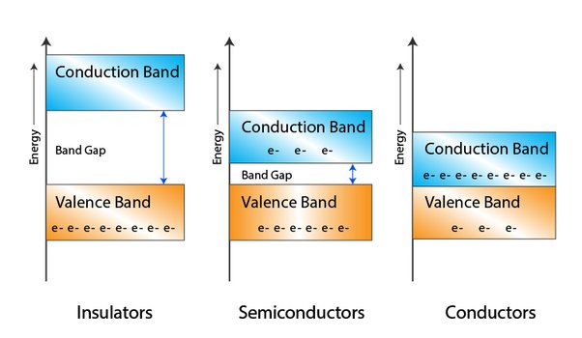
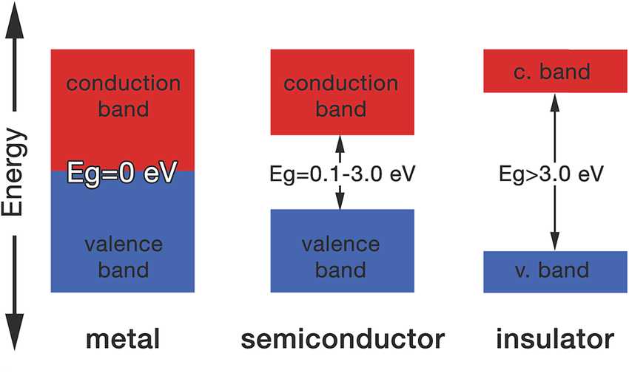
Introduction to inorganic semiconductors, classification of semiconductors; extrinsic and intrinsic semiconductors, n- and p- type semiconductor

Slide 3
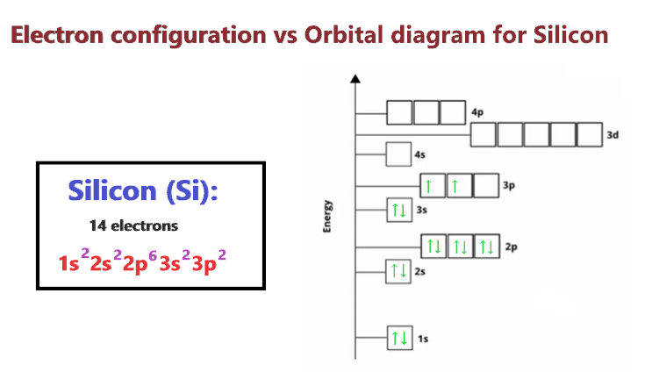
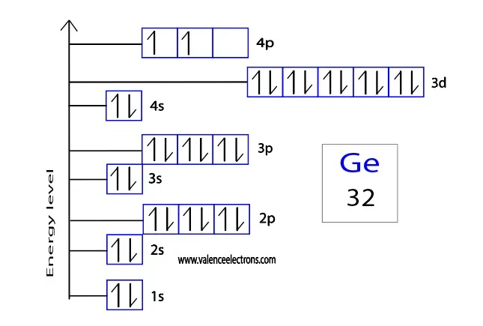
Classification of Inorganic Semiconductors
Inorganic semiconductors 1. Intrinsic semiconductor, 2. Extrinsic semiconductors
An intrinsic semiconductor is a semiconductor in which no other material is intentionally doped (similar to mixing). Example: Si, Ge.
In intrinsic semiconductor, when the valence electrons broke the covalent bond and jumps into the conduction band, two types of charge carriers gets generated. They are free electrons and holes.

Slide 4
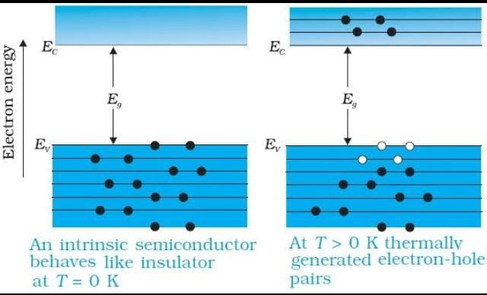
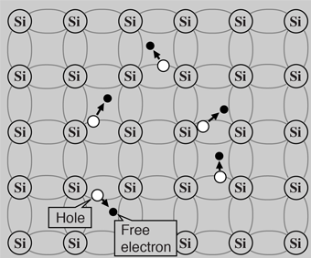
Classification of Inorganic Semiconductors
Inorganic semiconductors 1. Intrinsic semiconductor, 2. Extrinsic semiconductors

Slide 5
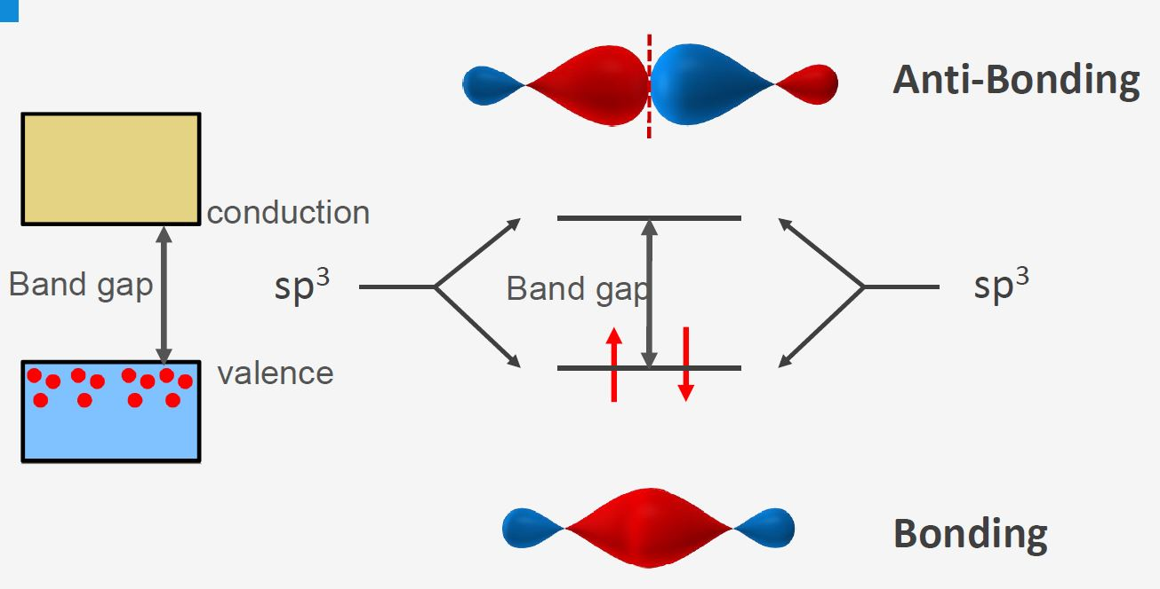

Slide 6
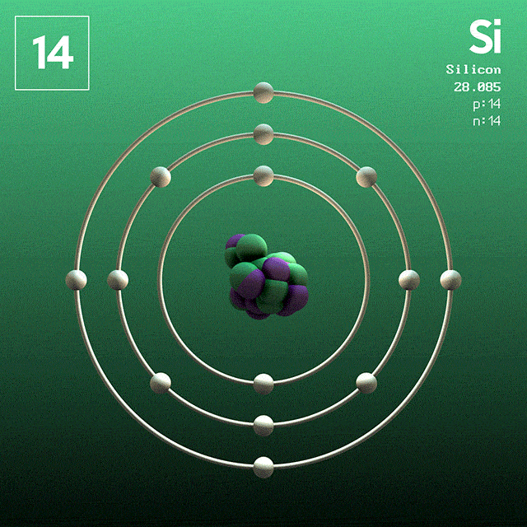
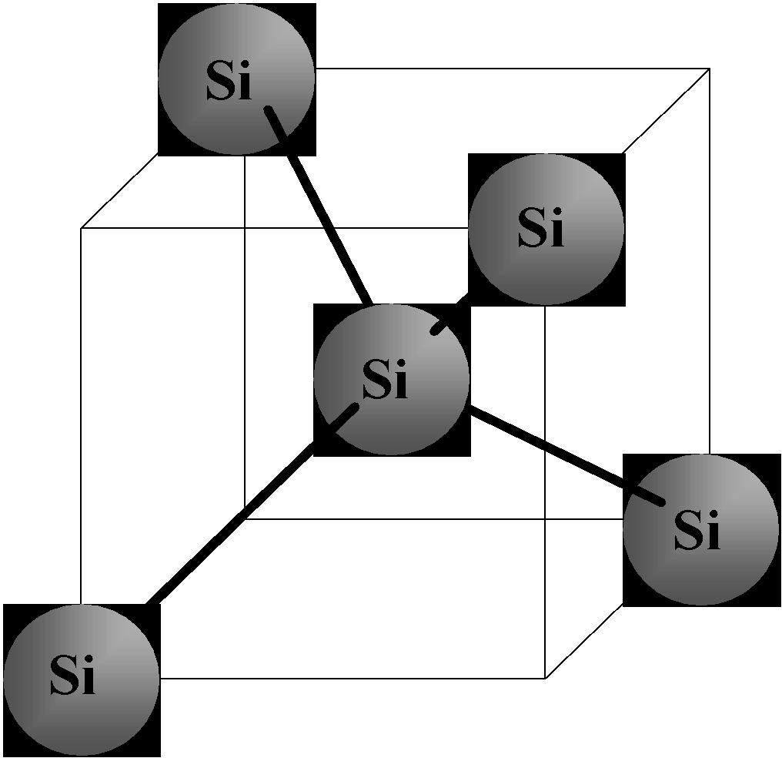
Silicon
Shared electrons
Si
Si
Si
Si
Si
Si
Si
Si
-
Si
Silicon is group IV element – with 4 electrons in their valence shell.
When silicon atoms are brought together, each atom forms covalent bond with 4 silicon atoms in a tetrahedron geometry.

Slide 7
n-type Doping
Conducting band, E_{c}
Si
Si
Si
Extra
E_{d} ~ 0.05 eV
Electron
Si
As
Si
E_{g} = 1.1 eV
Si
Si
-
Si
Valence band, E_{v}
Doping silicon lattice with group V elements can creates extra electrons in the conduction band — negative charge carriers (n-type), As- donor.
Doping concentration #/cm³ (10¹⁶/cm³ ~ 1/million).

Slide 8
p-type doping
Conducting band, E_{c}
Si
Si
Si
Hole
E_{g} = 1.1 eV
Si
B
Si
E_{a} ~ 0.05 eV
Si
Si
-
Si
Valence band, E_{v}
Electron
Doping silicon with group III elements can creates empty holes in the conduction band — positive charge carriers (p-type), B-(acceptor).

Slide 9
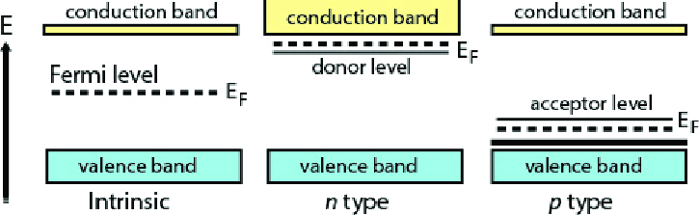
Energy Level Diagram of Semiconductors
n_{e} = n_{h}
n_{e} > n_{h}
n_{e} < n_{h}
n_{e} : Number of electrons, n_{h} : Number of holes

Slide 10
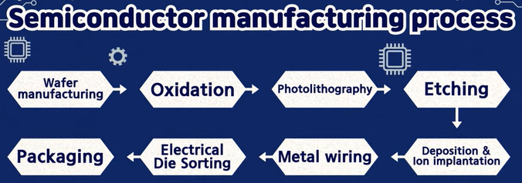
Semiconductor Manufacturing Process
https://www.youtube.com/watch?v=Bu52CE55BN0
https://www.youtube.com/watch?v=cjx55LNnbNQ
https://www.youtube.com/watch?v=TZxD2ePrphY

Slide 11
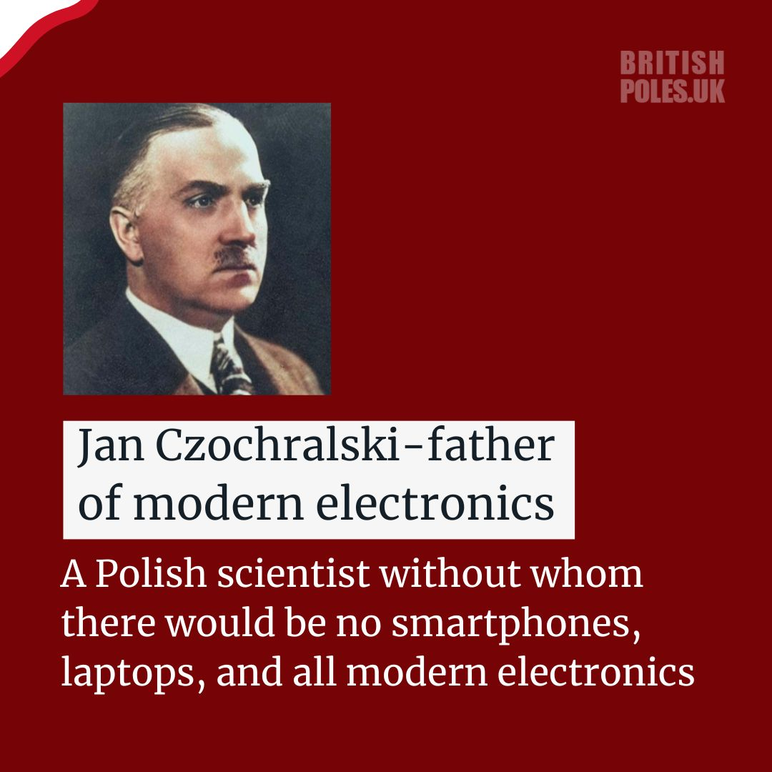

Slide 12
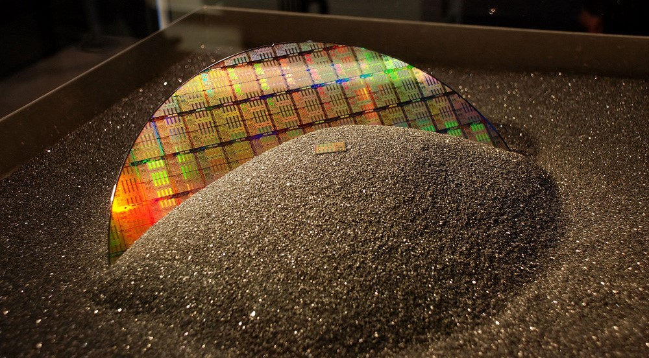

Slide 13
Silicon being the most abundant element in nature, just after oxygen. Its environmentally friendly properties are a bonus. Once silicon is extracted from sand, it needs to be purified before it can be use. First, it is heated until it melts into a high-purity liquid then solidified into a silicon rod, or ingot, using common growing methods like the Czochralski (chokh-RAL-skee) process or the Floating Zone process. In these process, a cylindrical ingot of high purity monocrystalline semiconductor, such as silicon or germanium, called a boule, is formed by pulling a seed crystal from a melt. These ingots are then sliced into wafers about 0.75 mm thick. The thin slice obtained through cutting process is called “die” that is an unprocessed “raw wafer‟. The die surface is uneven and polished to remove surface defects through grinding and chemical etching processes then to smooth surface trough polishing to obtain mirror-smooth finish

Slide 14
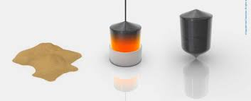
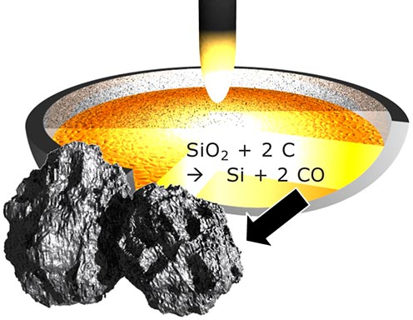
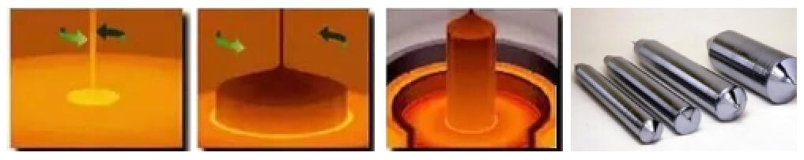
Czochralski method
Sand (SiO2) is heated at 2000 deg in the presence of carbon produces 98% Si
Then 98% Si is further heated at 900 deg in hydrogen atmosphere, to produce 99.999% Si
The 99.999% Si heated to melt in inert atmosphere and using Czochralski method, Si Ingots are crystallised.

Slide 15
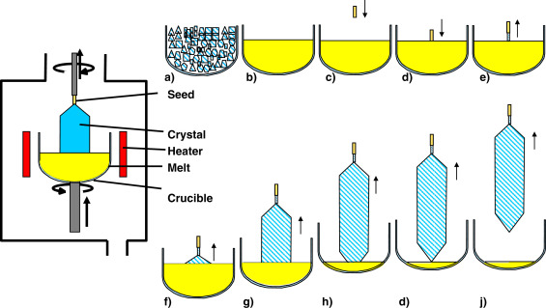
Czochralski (chokh-RAL-skee) process
https://www.sciencedirect.com/topics/chemistry/czochralski-process

Slide 16
Czochralski (chokh-RAL-skee) process
Process: At the beginning of the process, the feed material is put into a cylindrically shaped crucible and melted by resistance or radio-frequency heaters. After the feed material is completely molten a seed crystal with a diameter of typically a few mm is dipped from top into the free melt surface and a small portion of the dipped seed is melted. A melt meniscus is formed at the contact interface between seed and melt. Then, the seed is slowly withdrawn from the melt (often under rotation) and the melt crystallizes at the interface by forming a new crystal portion. During the further growth process, the shape of the crystal, especially the diameter, is controlled by carefully adjusting the heating power, the pulling rate and the rotation rate of the crystal. Usually, an automatic diameter control is applied.

Slide 17
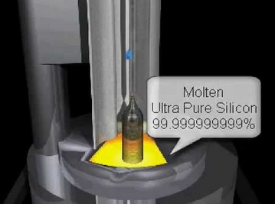
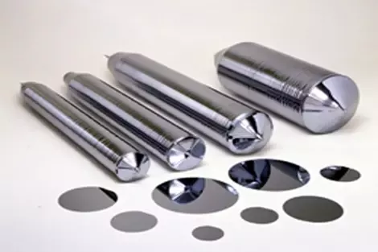
Step 1. Wafer manufacturing Processing
Typical wafer is made out of extremely pure silicon (99.9999999% or higher)

Slide 18
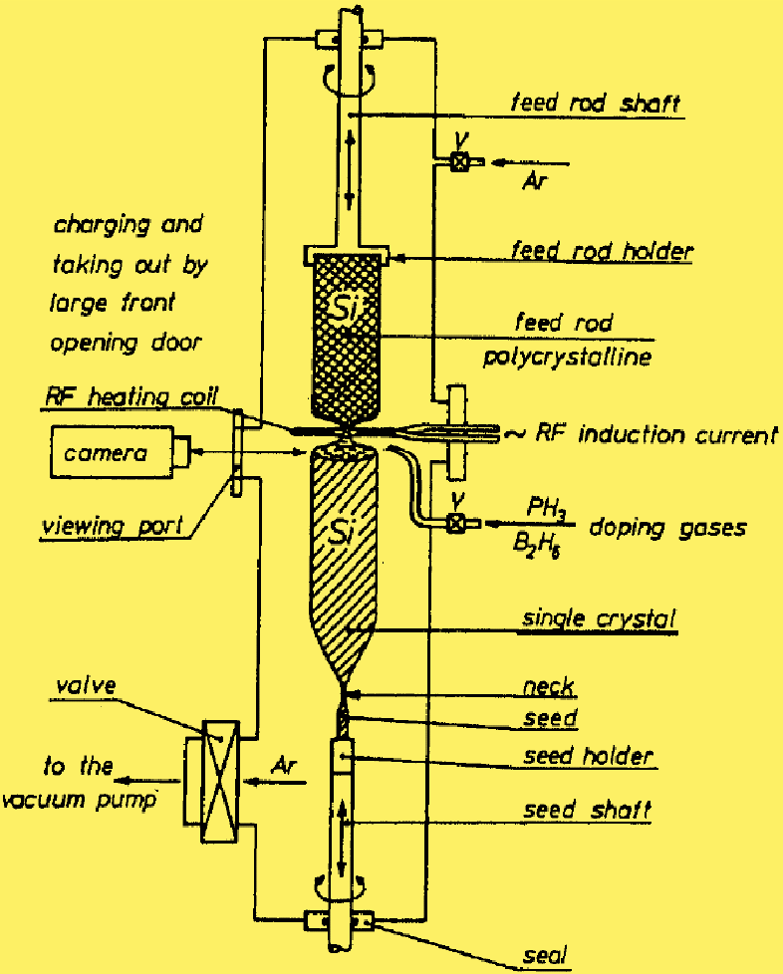
The float zone method
The float Zone (FZ) method is based on the zone-melting principle and was invented by Theuerer in 1962. A schematic setup of the process is shown in Figure.
Process: The FZ consists of closed reactor with no furnace.
The production takes place under vacuum or in an inert gaseous (Ar) atmosphere. The process starts with a high-purity polycrystalline rod and a monocrystalline seed crystal that are held face to face in a vertical position and are rotated. Initially, the Si seed crystal pulls the molten Si from polycrystalline Si rod, as a result the monocrystalline Si rod crystallizes. The RF induction heater is slowly with the controlled rate is raised up, as it induces localized temperature melts Poly Si inside the RF coil. The Polycrystalline Si rods above RF coil and Monocrystalline Si rod below RF coil are in solid crystallized form, however they are rotating opposite to each other when RF coil is moving up. For doing P and B, the required amounts of respective gasses PH3, BH3 are being fed to molten zone. Once the RF coil completely transforming the polycrystalline Si to monocrystalline Si. The current supply to RF heater is stopped. The Supply of all inputs gasses dopants/Ar is also stopped. Finally, the Single crystalline Si rod is taken out and sliced into wafers to make semiconducting chips.

Slide 19
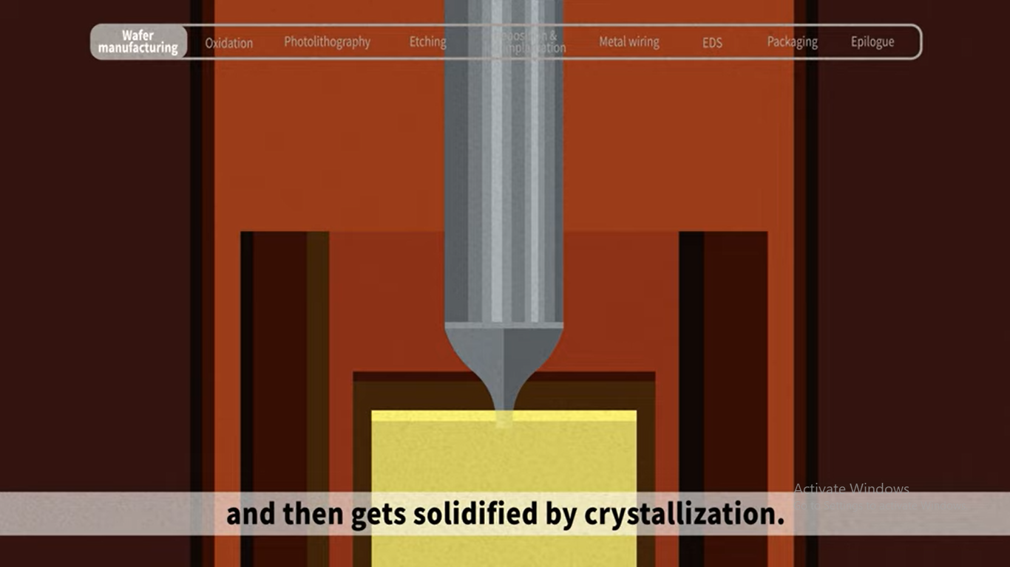
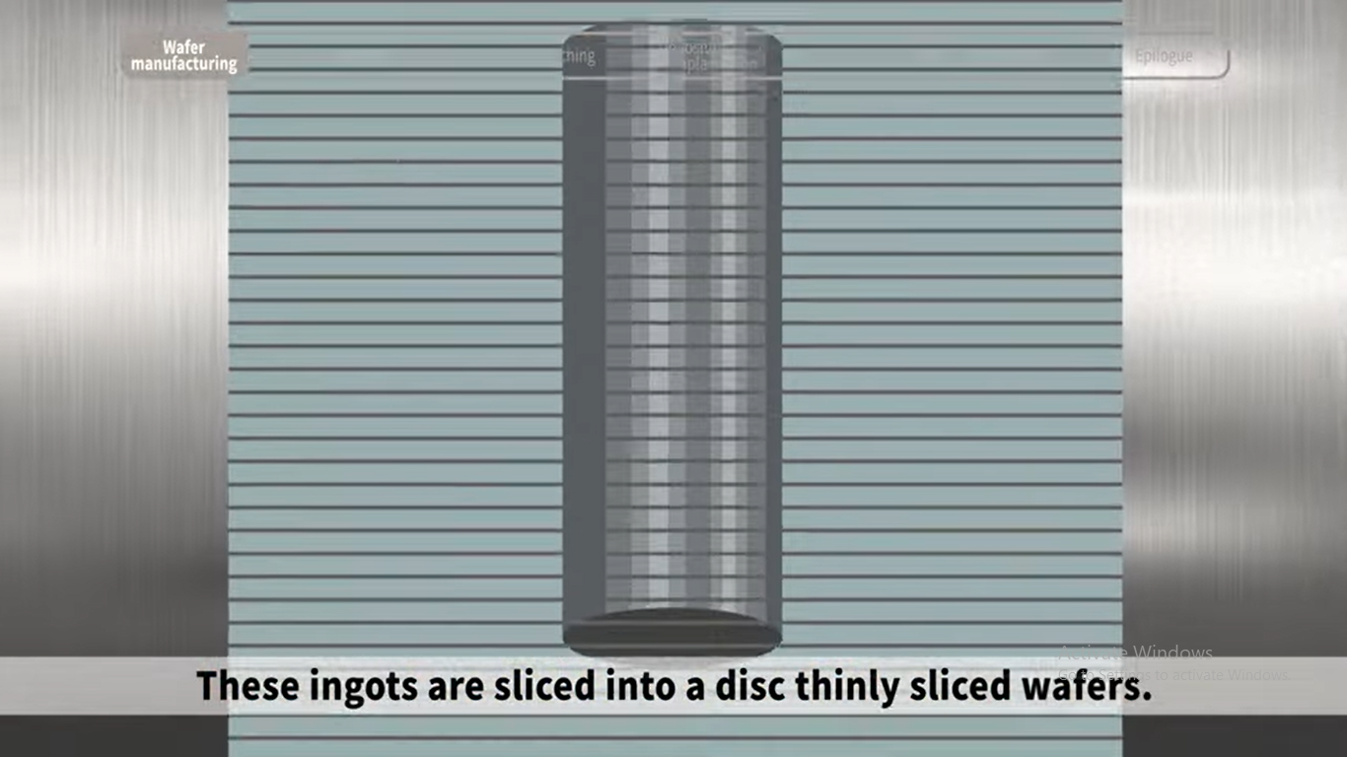
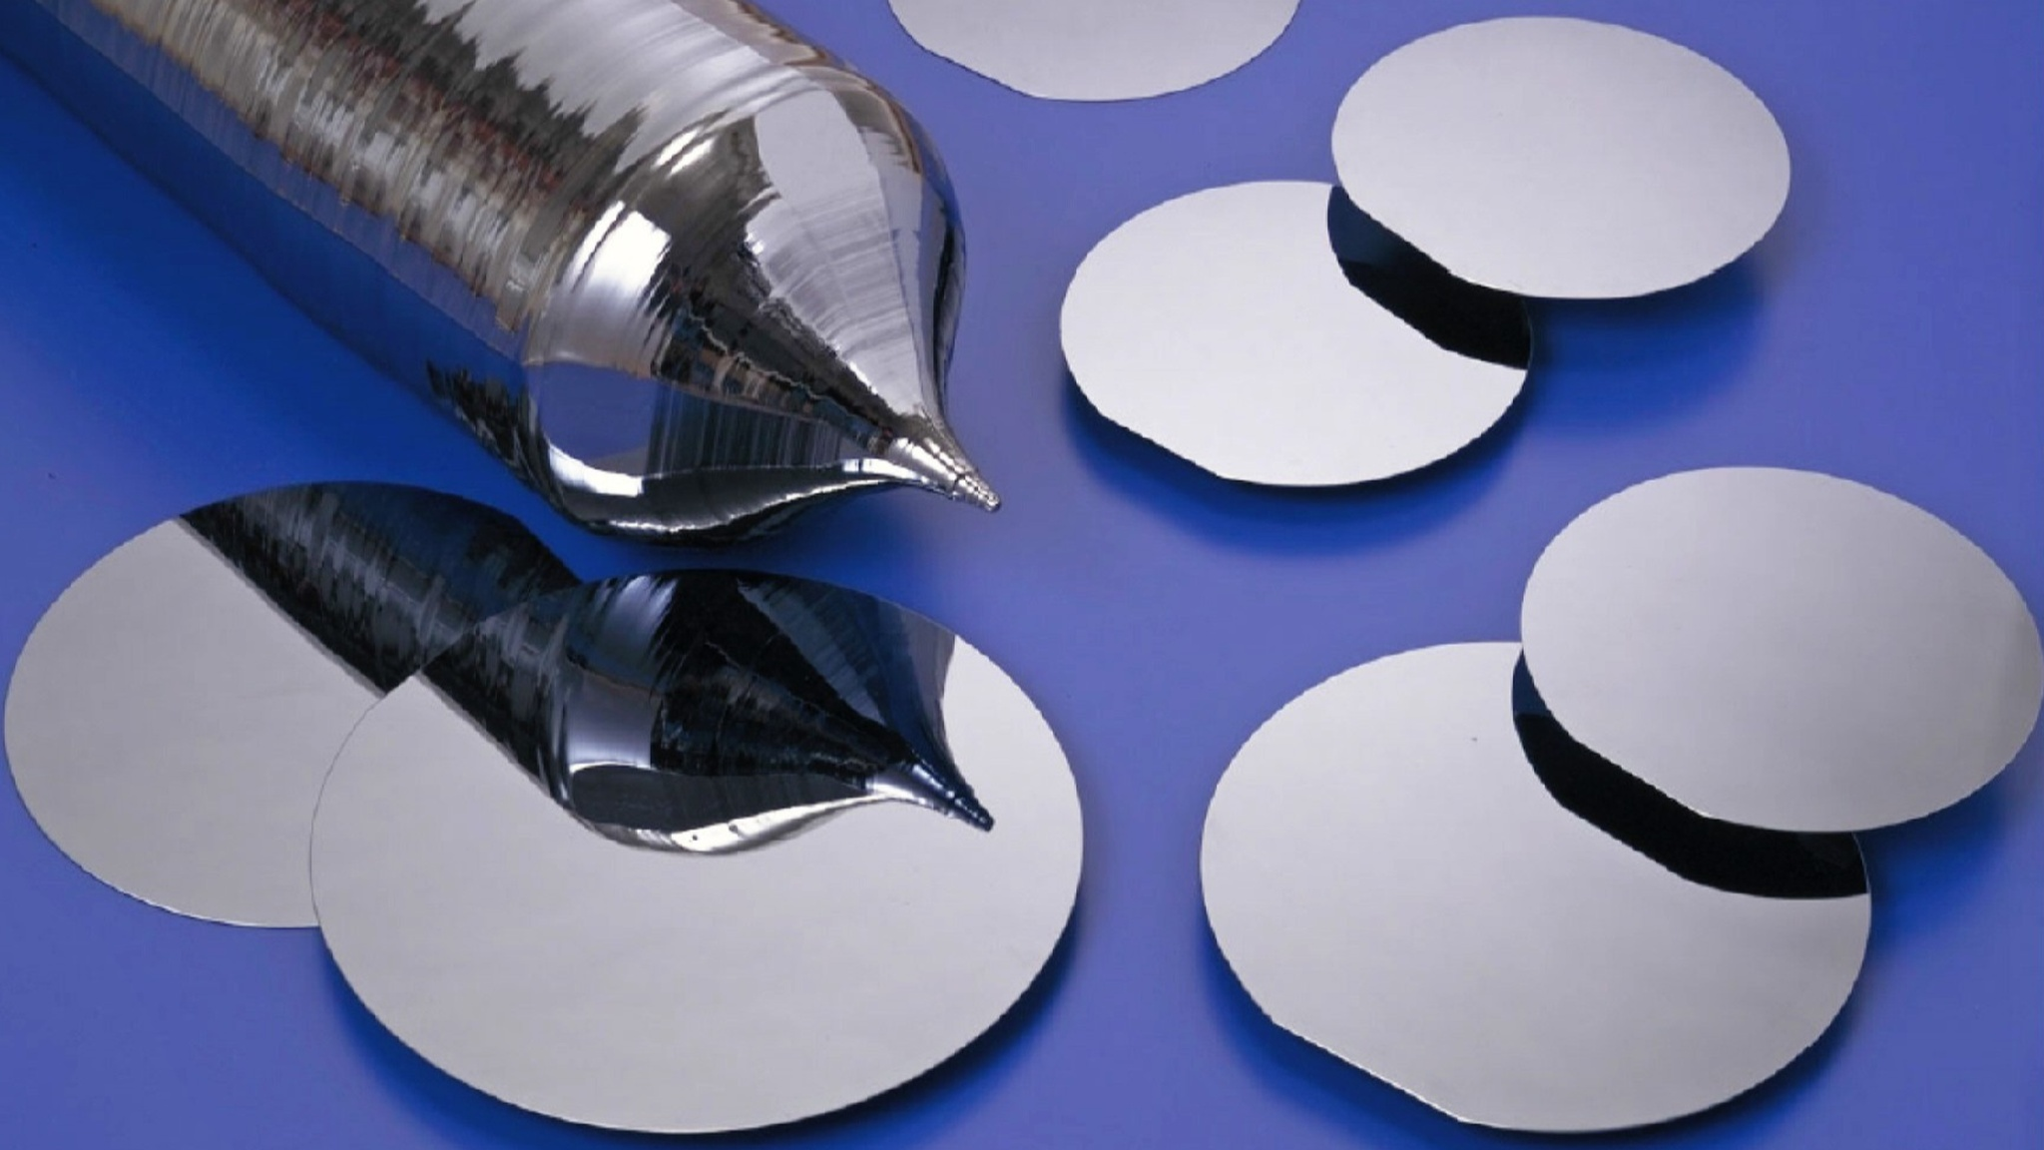
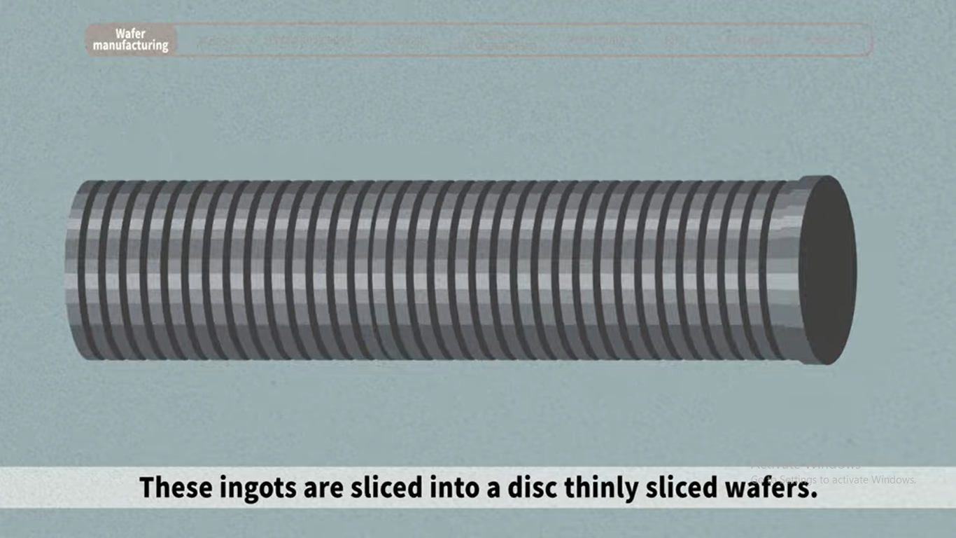
Step 1. Wafer manufacturing Processing

Slide 20
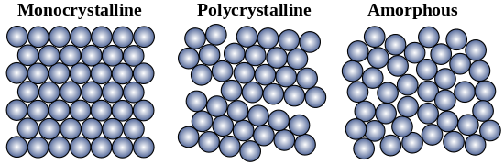
Si in various crystalline form

Slide 21
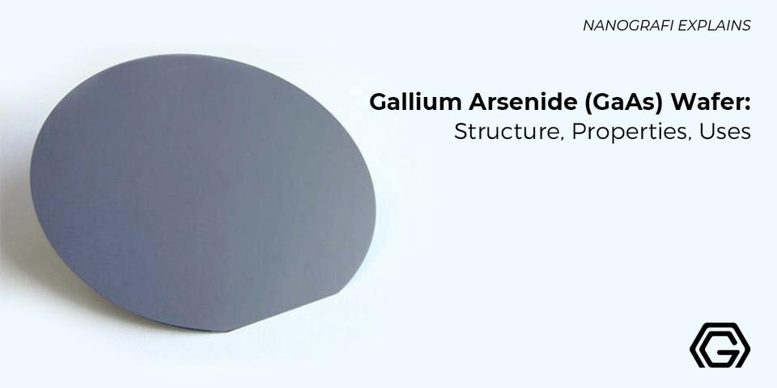
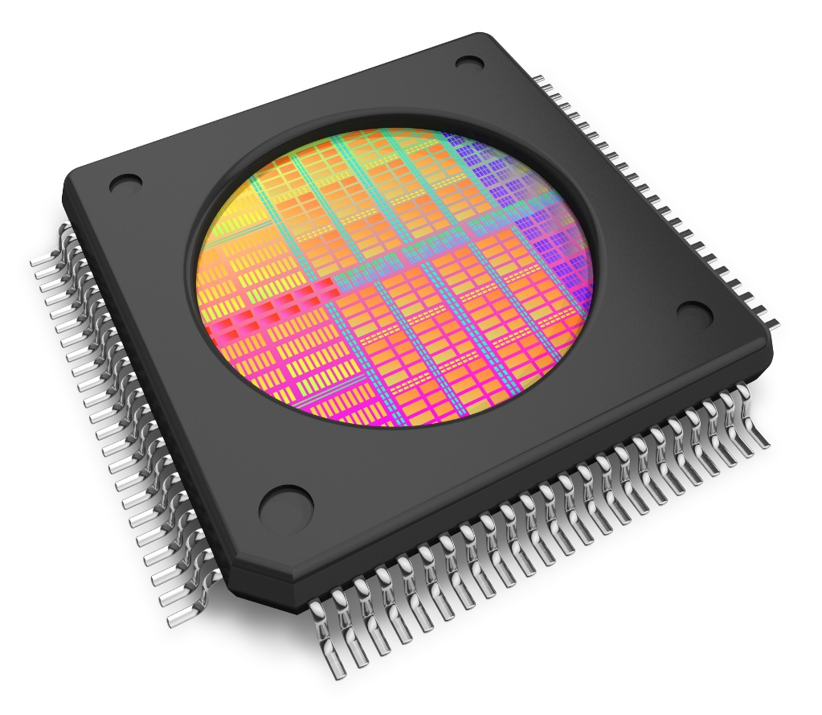

Slide 22
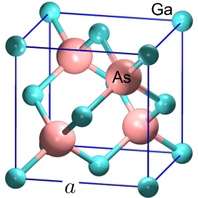
GaAs is a III–V group direct band gap semiconductor composed of the element gallium (Ga) from column III and the element arsenic (As) from column V of the periodic Table.
The Molar mass of Gallium arsenide (GaAs) is 144.64 g/mol.
Gallium arsenide (GaAs) has the Melting point of 1238 °C.
Structure of Gallium Arsenide (GaAs: FCC
In the Gallium arsenide (GaAs) wafer, each gallium atom is bordered by arsenic atoms. 5 valence electrons of arsenic atoms and 3 valence electrons of gallium atoms share each other. So, each of the gallium and arsenic atom gets 8 valence electrons in the outer shell. It is also to be noted that a covalent bond exists between gallium and arsenic atom in the GaAs Wafer. The covalent bonds despite being strong can be broken with an enough amount of external energy.

Slide 23
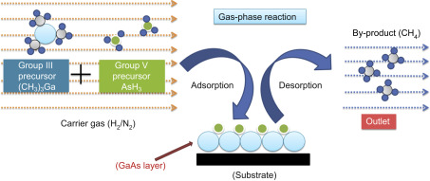
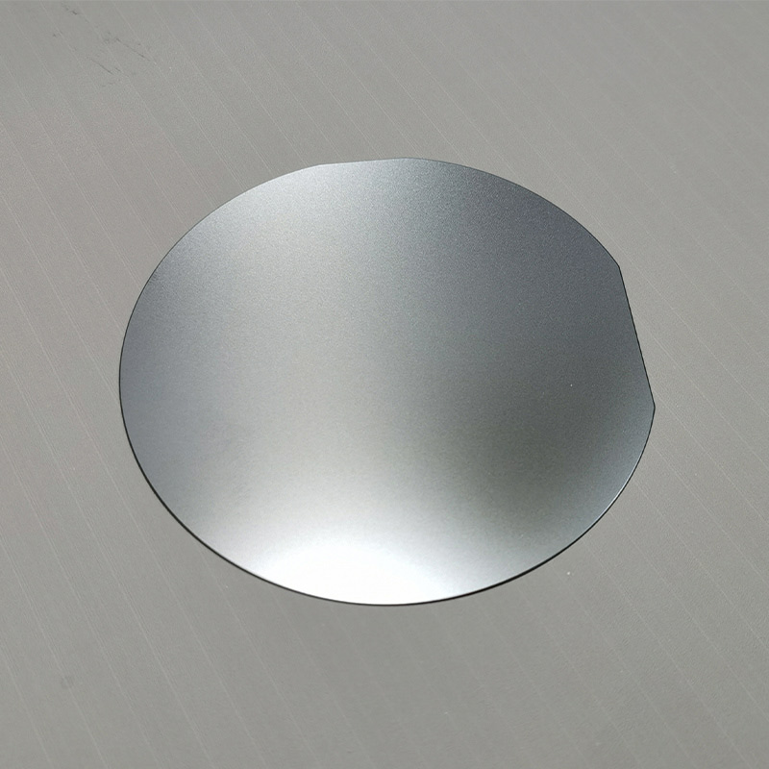
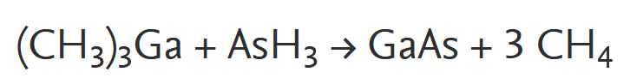
GaAs preparation by using MOCVD

Slide 24
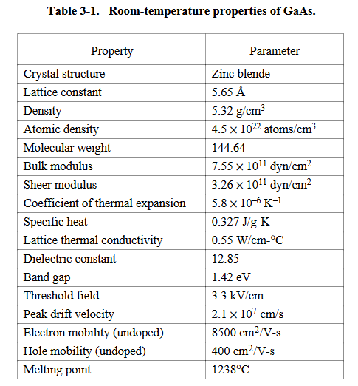
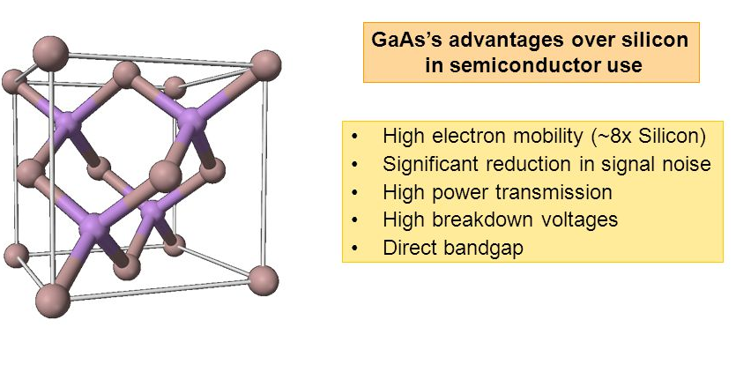
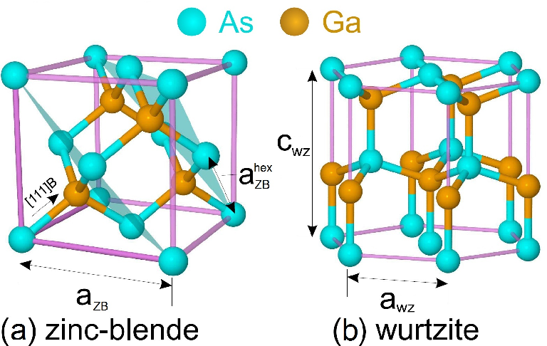

Slide 25
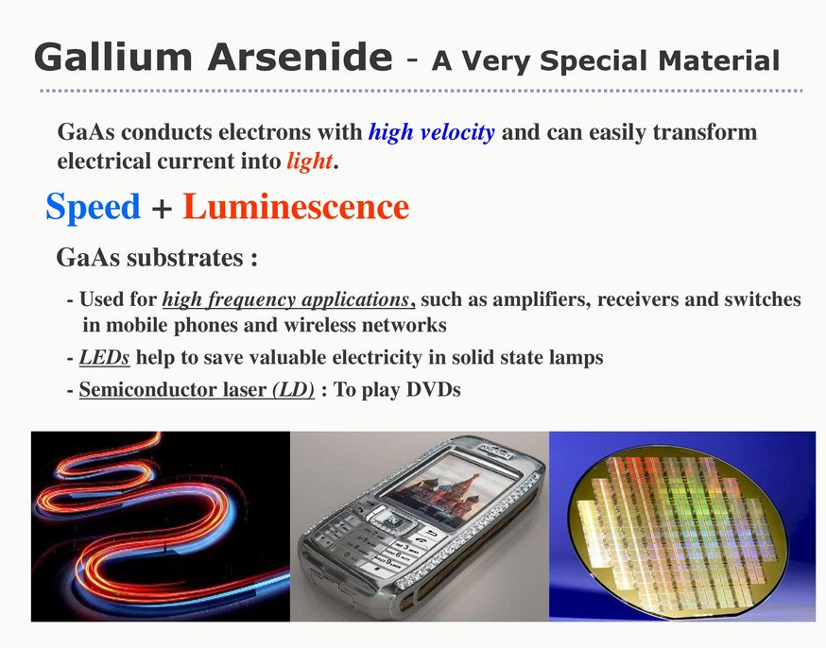
Use of Gallium Arsenide (GaAs) Wafer
Computers
Photovoltaic cells
Optoelectronic communications
Laser diodes and infrared emission

Slide 26
Microwave frequency integrated circuits (MFICs): GaAs semiconductors are used for making MFICs that operate at frequencies above 1 GHz, such as amplifiers, mixers, oscillators, switches, and filters. These circuits are used for communication systems, radar systems, satellite systems, and wireless systems. The advantages of using GaAs for MFICs are high speed, low noise, low power consumption, high gain, high linearity, and wide bandwidth.

Slide 27
Applications of of Gallium Arsenide (GaAs) Wafer
Gallium has superior electronic properties compared to silicon, such as higher electron mobility and saturated electron velocity. This allows gallium arsenide to function at frequencies up to 250 GHz in transistors. It is less sensitive to high temperatures, generates less noise in electronic circuits, and provides efficient light absorption and emission due to its direct bandgap.
Gallium arsenide's resistive nature and high dielectric constant make it an ideal substrate for integrated circuits, offering natural isolation between components.
These properties make gallium arsenide a promising candidate for applications in satellites, mobile phones, communication technology, and monolithic microwave integrated circuits (MMICs). Wafers, which are thin semiconductor layers used in microelectronic devices, undergo modifications like ion implantation, doping, thin film deposition, and etching to be applied effectively

Slide 28
Monolithic microwave integrated circuits (MMICs): GaAs semiconductors are used for making MMICs that integrate multiple MFICs on a single chip, such as transmitters, receivers, modulators, demodulators, and converters. These circuits are used for communication systems, radar systems, satellite systems, and wireless systems. The advantages of using GaAs for MMICs are high integration density, high performance, low cost, low weight, and small size.
Infrared light-emitting diodes (LEDs): GaAs semiconductors are used for making LEDs that emit light in the infrared region (700 nm to 1 mm) of the electromagnetic spectrum. These LEDs are used for remote controls, optical sensors, optical communication systems and night vision systems. The advantages of using GaAs for LEDs are high efficiency, long lifetime, low cost and easy fabrication.
Laser diodes: GaAs semiconductors are used for making laser diodes that emit coherent light in the infrared region (700 nm to 1 mm) of the electromagnetic spectrum. These laser diodes are used for optical communication systems, optical storage systems, and medical applications such as surgery and therapy. The advantages of using GaAs for laser diodes are high power output, high modulation speed, and narrow spectral linewidth.
Solar cells: GaAs semiconductors are used for making solar cells that convert sunlight into electricity. These solar cells are used for space applications and terrestrial applications such as rooftop panels and concentrator systems. The advantages of using GaAs for solar cells are high efficiency, high radiation resistance, high-temperature tolerance, and wide spectral response.
Optical windows: GaAs semiconductors are used for making optical windows that transmit light in the infrared region (700 nm to 1 mm) of the electromagnetic spectrum.
These optical windows are used for infrared cameras, thermal imaging systems, and spectroscopy instruments. The advantages of using GaAs for optical windows are high transparency, low absorption, low reflection, and low scattering.

Slide 29
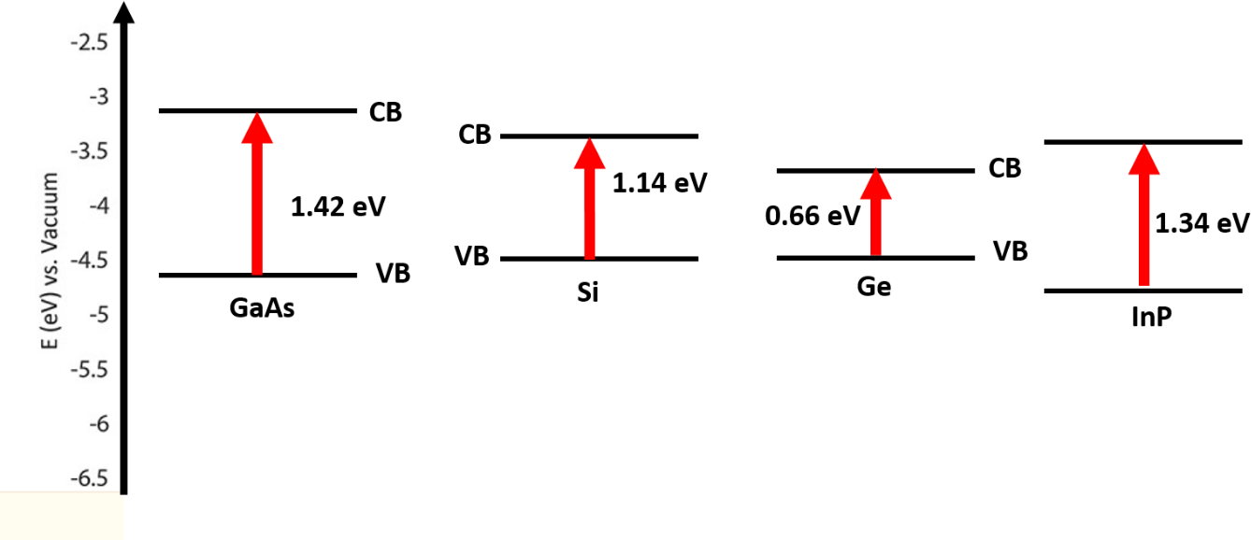
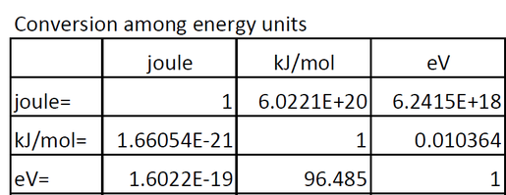
Direct band gap of Inorganic Semiconductor

Slide 30
Background of Direct and Indirect band gap
Band theory of solids plays an important role in understanding the behavior of semiconductors in response to applied electric and magnetic fields. The theory is used to evaluate the energy of electrons in momentum space/reciprocal space for different crystalline semiconductors as well. According to this theory at absolute zero K, a typical semiconductor contains energy band that is completely filled (Valence Band, VB) with the electrons and an energy band that is empty (conduction band.,CB). Conduction band is usually high in energy when compared to the valence band and it contains plenty of empty excited states for electrons to occupy.
The gap that is present in between the lowest energy point in the CB and the lowest energy point in the VB is called energy gap or forbidden energy gap. The lowest energy point generally presents at the lowest edge of the CB. Where as the lowest energy point in the valence band is generally located at the top of the VB edge. Please note that the energy band curvatures are usually opposite for the conduction band and the valence band.(SEE FIG IN NEXT SLIDE)
Since, these energy bands are plotted for various directions in the momentum space/reciprocal space. In other words, the plot is drawn between the energy (ordinate) versus momentum (abscissa) of electrons for various directions in the reciprocal lattice.
If the lowest energy of electrons present in the CB and VB occurs at the same value of momentum on the abscissa scale. Then the semiconductor is said to be direct. Otherwise, if they happen at different values of momentum on abscissa then the semiconductor is said to indirect.

Slide 31
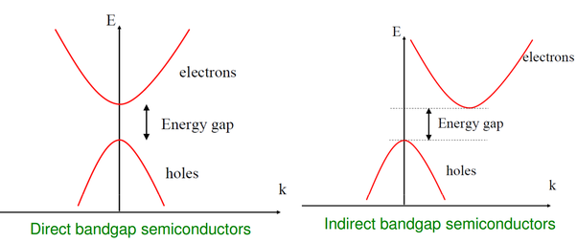
Direct and Indirect band gap
An indirect band gap is where the maximum of the VB and the minimum of the CB occur at different values of k. The maximum of the VB is at k = 0, but the minimum in the CB is at a k vector.
Silicon is an indirect band gap semiconductor with a band gap of 1 . 12 eV, and its direct gap is 3.5 eV.

Slide 32
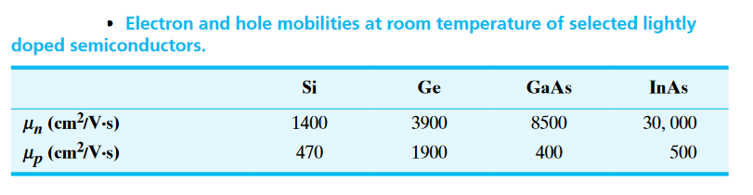
Drift Velocity of Semiconductors
When an electric field is applied across a semiconductor material, a current is produced due to the flow of charge carriers. The drift velocity is the average velocity of the charge carriers in the drift current.
Carrier Drift is, charged particle motion in response to an applied electric field. When an electric field is applied across a semiconductor, the carriers start moving, producing a current.
The drift velocity of electrons and holes in silicon has been measured in a large range of the electric fields (from 3.10² to 6.10⁴ V/cm) at temperatures up to 430 K.

Slide 33
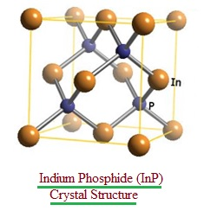
Indium Phosphide (InP)
Indium phosphide (InP) is an important III–V semiconductor, it exists in two crystalline forms wurtzite (WZ) and zinc blende (ZB) with direct band gaps of 1.42 and 1.35 eV at room temperature, respectively, and is a highly promising candidate for construction of viable integrated circuits.
Compared to II–VI and I–VII semiconductors, the IIIA phosphides have a high degree of covalent bonding, a less ionic character and larger exciton diameters.
It has superior electron velocity due to which it is used in high-frequency and high-power electronics.
It can be prepared by MOCVD method.

Slide 34
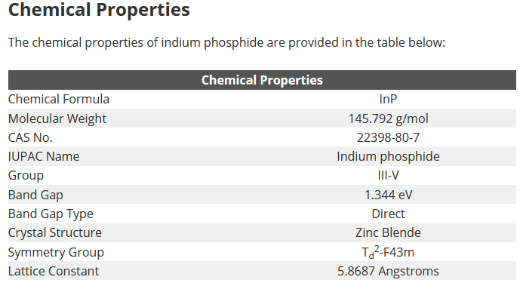

Slide 35
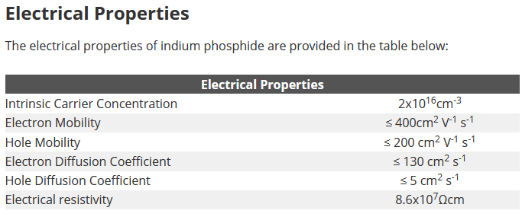

Slide 36
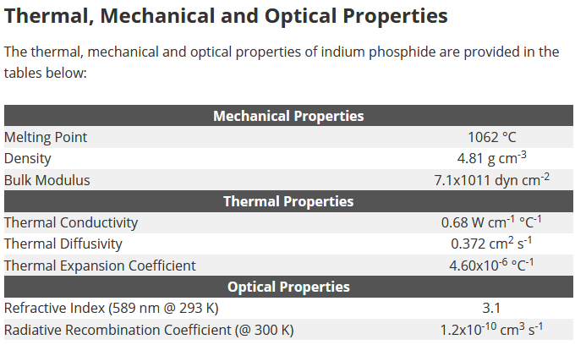

Slide 37
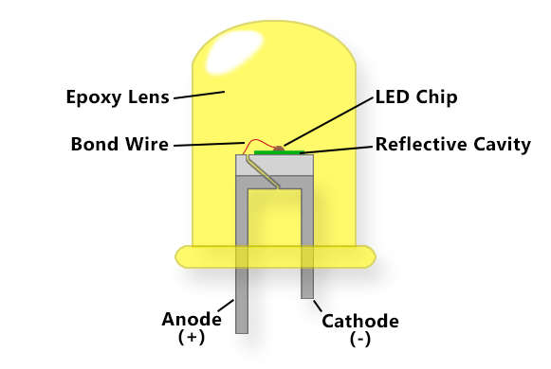
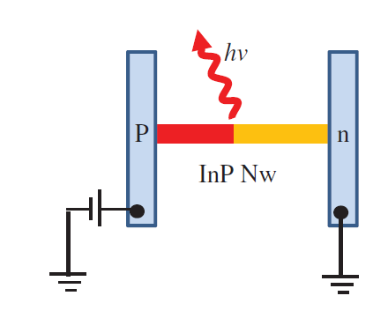
InP nanowires (NWs) and their applications in optoelectronic devices, such as solar cells, photodiodes, photodetectors, light-emitting diodes (LEDs) and field effect transistors (FETs).
InP Quantum Dot-Based Light-Emitting Diodes

Slide 38
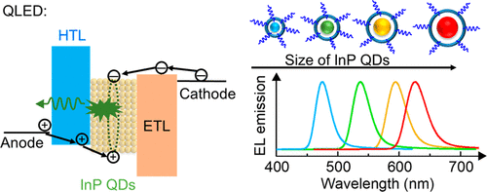
High-performance quantum dot light-emitting diodes (QLEDs) are being considered as a next-generation technology for energy efficient solid-state lighting and displays. InP QLEDs are the most promising alternative to the toxic CdSe QLEDs. Unlike the problems of poor hole injection in CdSe-based QLEDs, highly delocalized electrons and parasitic emissions are serious problems in green-emitting InP QLEDs
https://doi.org/10.1021/acsenergylett.9b02824

Slide 39
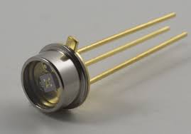
InP applications in photodiodes
A photodiode is a PN-junction diode that uses light energy to generate electrical energy. It is sometimes called a photo-detector, a light detector, and a photo-sensor.
Principle of Photodiode: It works on the principle of the photoelectric effect. The operating principle of the photodiode is such that when the junction of this two terminal semiconductor device is illuminated then the electric current starts flowing through it.

Slide 40
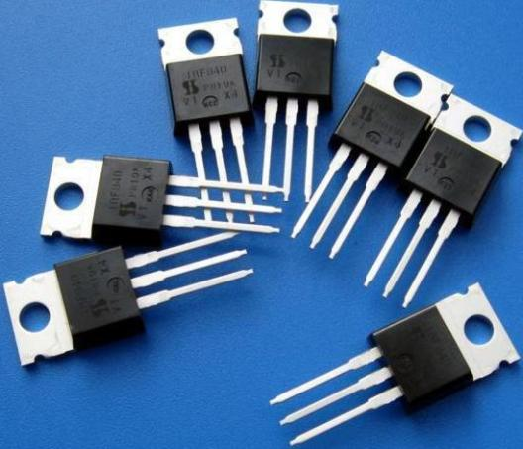
Field effect transistors (FETs):
It is a type of transistor commonly used for weak-signal amplification (for example, for amplifying wireless signals). The device can amplify analog or digital signals

Slide 41
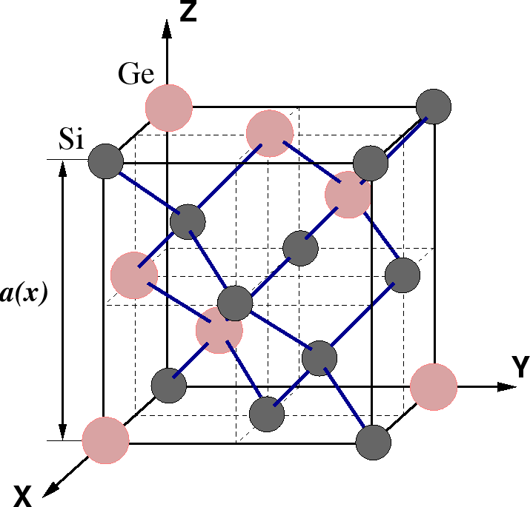
Silicon-Germanium Alloys
Silicon-germanium (SiGe) is an IV-IV compound semiconductor which offers enhanced carrier mobility and a higher dopant solubility compared to pure silicon.
Silicon and germanium are completely miscible over the full range of compositions and hence can be combined to form Si1-xGex alloys with the germanium content, x, ranging from 0 to 1 (0 -100%). Si1-xGex has a diamond-like lattice structure

Slide 42
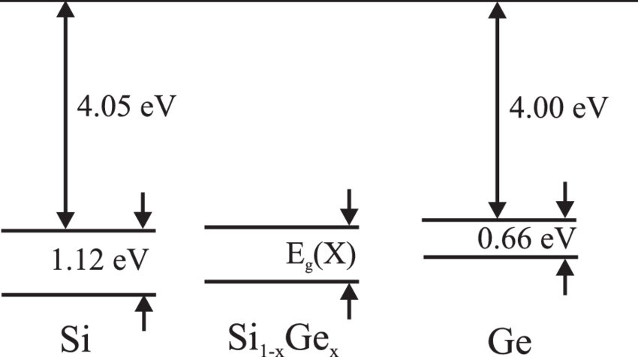
The energy band gap of silicon and germanium are 1.12eV and 0.66 eV.

Slide 43


Slide 44

Silicon-germanium is an important material that is used for the fabrication of SiGe
heterojunction bipolar transistors.
strained Si metal-oxide-semiconductor (MOS) transistors for advanced complementary metal—oxide-semiconductor (CMOS) and
BiCMOS (bipolar CMOS) technologies.
It also has interesting optical properties that are increasingly being applied in silicon-based photonic devices

Slide 45
Applications of SiGe in
nanoelectronics, (ii) energy conversion,(Thermoelectric) and (iii) spintronics
SiGe systems for electronics
applications lies in the possibility to integrate analog, radio frequency, and digital on a single chip using existing complementary metal oxide semiconductor (CMOS) fabrications
technologies, which is not possible with any other technologies (like, e.g., devices based on GaAs).

Slide 46
Organic Semiconductor: (OSCs)
OSCs are semiconducting materials having carbon and hydrogen being their basic constituents with π-conjugated structure, which includes single molecules, short chain (oligomers) and polymers).
Almost all organic solids are insulators, but when their constituent molecules have π-conjugate systems, charge carriers can move via π-electron overlaps, especially by hopping, tunnelling and related mechanisms.
They have quite different conduction mechanisms to inorganic semiconductors; for example, in the case of small molecules the charge carriers are typically localised to single molecular orbitals, known as the highest occupied molecular orbital (HOMO) and lowest unoccupied molecular orbital (LUMO).
They have wide range of applications in devices like OFETs, OLEDs, organic solar cells, etc.

Slide 47

Organic Semiconductor: (OSCs)
Figure : Schematic of energy-level splitting and absorption in alkenes with increasing conjugation length, highlighting the lowest-energy optical transitions from HOMO to LUMO. The bandgap of polyacetylene depends on both the number of monomers n and the effective conjugation length in the polymer. Arrows represent spin-paired electrons.

Slide 48

Organic Semiconductor (OSCs)
Molecular structure of some prototype organic semiconductors: PPV, poly(p-phenylenevinylene); PFO, polyfluorene; P3AT, poly(3-alkylthiophene); CuPc, Cu-phthalocyanine; fullerene, C60; Alq3, tris(8-hydroxyquinoline)aluminium; pentacene.

Slide 49


Pentacene and Synthesis
Pentacene is a benchmark organic semiconductor in thin-film organic electronic devices due to its π-conjugated electronic structure, its relatively low HOMO-LUMO gap and the relatively high charge carrier mobility of its solid state films. It is the most common p-type organic semiconductor in OFET devices
Pentacene is a deep blue, crystalline material of high reactivity that shows only sparing solubility in organic solvents.
Scheme 1. The first synthesis of pentacene
Successive Friedel-Craft acylations of m-xylene using benzoyl chloride produces 1,3-dibenzoyl-4,6-dimethylbenzene. With further heating in the presence of copper, the diketone is transformed to 6,13-dihydropentacene. Transfer dehydrogenation in the presence of phenanthraquinone and nitrobenzene yields pentacene
https://doi.org/10.3390/molecules17044625

Slide 50

Pentacene and Synthesis
Scheme 2. Synthesis of pentacene from pentacene-6,13-dione using a Hg-Al amalgam.
The reduction of pentacene-6,13-dione using either Al in cyclohexanol (5–51% yield) or an Al/HgCl₂ mixture in cyclohexanol/carbon tetrachloride requires 48h to produce pentacene (54% yield)
https://doi.org/10.3390/molecules17044625

Slide 51


Pentacene and derivatives
silylethynyl pentacenes (TIPS)
Pentacene (1), phenylethynyl pentacene
(2) and silylethynyl pentacenes (TIPS) (3).
The 6,13-bis(triisopropylsilylethynyl) pentacene derivative (3) has proven to be quite successful for applications in organic electronics and is the most intensively studied soluble pentacene.
The optical energy gap of pentacene is 1.8 eV and that of TIPS pentacene is 1.6 eV.
Band structure calculations on a variety of silylethyne-substituted pentacenes show significant dispersion in both the conduction and valence bands, predicting significant potential for high hole and electron mobility

Slide 52

Doped Pentacene

Slide 53


Pentacene and derivatives
Singlet and triplet energy levels of pentacene compared to the HOMO and LUMO energy levels of C60 and BsubPcs: Cl-BsubPc, Cl-Cl6BsubPc, and Cl-Cl12BsubPc. HOMO and LUMO energy levels
J. Phys. Chem. Lett., 2015, 6 (15), 3121–3125.

Slide 54


Fullerene and Derivatives
Fullerene is an allotrope of carbon. A fullerene is any series of hollow carbon molecules that form either a closed cage, as in a buckyball, or a cylinder, like a carbon nanotube. Fullerene molecules are named according to the number of carbon atoms in the structure. The most commonly created fullerene is the C60 molecule. It is also termed as Buckminsterfullerene. It has been named after an American architect Buckminster. The fullerene C60 is composed of 60 carbon atoms and has a diameter of 7.09 A°. The C60 molecule is composed of 20 hexagonal and 12 pentagonal faces to form a spherical structure similar to a soccer ball with a diameter of ≈10 Å.
Buckminsterfullerene C 60 exhibits a band gap of 1.86 eV and its derivative PCBM is 1.3 to 1.5 eV.

Slide 55

Fullerene Synthesis
Historically, the first technique to synthesize fullerenes was based on laser ablation of graphite targets in a He gas; however, this does not produce large quantities of the material and is thus mostly used for research studies. The first method to produce large quantities (several grams per day) of fullerenes was first developed by Kratschmer et al. [http://dx.doi.org/10.1038%2F347354a0] and consisted of an AC arc discharge between high purity graphite rods in 100–200 Torr of helium (He) or Argon (Ar) gas and temp of 2000 °C. At this temperature, the electrodes evaporate carbon, forming soot that contains fullerenes, which then condenses on the cool walls of a reactor made of stainless steel or Pyrex.
C60 can be produced by the flash vacuum pyrolysis of polycyclic aromatic hydrocarbon consisting of 12 hexagons, including 3 Cl substituted and 3 pentagons at 1100 °C and 0.01 Torr. The three carbon chlorine bonds served as free radical incubators and the ball was stitched up in to C60.

Slide 56

Fullerene Derivatives- PCBM
[6,6]-phenyl-C₆₁-butyric acid methyl ester.
The general method for the synthesis of PCBM comprises two steps: (i) [2+1] cycloaddition to prepare fulleroid 2 from C60 and diazoalkane 1; (ii) isomerization of 2 leading to PCBM (3) (Scheme 1). The second step can be performed by thermal isomerization or photoisomerization.
PCBM optimal bandgap is around 1.3 to 1.5 eV.
https://doi.org/10.1002/ejoc.201700745
General method for the synthesis of PCBM (3) via fulleroid 2

Slide 57


Applications - Organic Solar Cells

Slide 58

Pentacene/Fullerene derivatives Applications
Organic Solar Cells
TIPS pentacene has found use as a donor in single-heterojunction solar cells (Figure ).
Solution deposited films of TIPS pentacene were paired with vacuum-deposited C60 (as an acceptor) to yield solar cells with 0.52% efficiency.
Alternatively, all vacuum- deposited single heterojunction cells with TIPS pentacene and C60 yielded solar cells with efficiency of 0.42%.
Dioxole-functionalized derivative 5 performed somewhat better in these vacuum-deposited devices, yielding efficiencies up to 0.74%.
Derivative 5 is an intensely fluorescent compound and has also been used to fabricate red organic light emitting diodes with external quantum efficiency of 3.3%.
TIPS
single-heterojunction organic solar cells (left) and light-emitting diodes (right). B

Slide 59
Fullerene Derivatives Applications
Organic Solar Cell (OPV) Materials
The OPV device usually requires a bulk heterojunction (BHJ) which can be fabricated by mixing an electron-donor (p-type semiconductor) and electron-acceptor (n-type semiconductor). The former material involves a π-conjugated polymer and a small molecule semiconductor, and the latter material is normally a fullerene derivative. PCBM is electron acceptors

Slide 60

Organic Solar Cell
(OPV) Materials
Fullerene Derivatives Applications

Slide 61

Fullerene Derivatives Applications
Organic thin film transistor (TFT)
The transistor output characteristics have been compared between the C60MC12- organic TFT and PCBM-organic TFT prepared in similar way as a reference specimen, to determine the electron mobility. The electron mobility of C60MC12-organic TFT has been as high as 0.067 cm²/Vs, much higher than that of PCBM-organic TFT, 0.023 cm²/Vs [Table 1]. This value is the highest in n-type organic semiconductor prepared by coating process. The current on/off ratio for switching device property is as high as 1.6 x 10⁵.
https://www.aist.go.jp/aist_e/list/latest_research/2004/20041118/20041118.html

Slide 62
Fullerene Derivatives Applications
Batteries/Supercapacitors : C60 and their derivatives are used for lithium batteries as they showed the electrochemical intercalation of lithium into solid C60, which corresponds to the C60Li12 form. It can be effectively used for anode materials in lithium–ion batteries.
Sensors: Excellent conductivity properties, charge transport, and charge separation make fullerene an ideal material for sensors. It has been used in various sensors, such as strain and gas sensors, photoelectrochemical sensors, and electrochemical and optical sensors.
Biomedical application Due to its excellent electrochemical sensitivity, C60 can be used for the detection of numerous biomolecules, in particular, dopamine, glucose, and uric acid.
Supercondcutors: Studies have shown that when an alkali metal is embedded within the voids of fullerene C60, the new composite formed becomes a super conductor (Wang et al., 2015). Accordingly, it has been reported that K3C60 composite possess high super conducting critical temperature with almost a perfect 3-D superconductivity, current density, ductility and high stability.

Slide 63

Organic Solar Cells
Pentacene as a hole transport material for high performance planar perovskite solar cells
https://doi.org/10.1016/j.cap.2018.05.022

Slide 64


Organic field-effect transistors (OFETs)
Field-effect transistors usually operate as a capacitor. They are composed of two plates. One plate works as a conducting channel between two ohmic contacts, which are called the source and the drain contacts. The other plate works to control the charge induced into the channel, and it is called the gate.
https://doi.org/10.1051/epjap/2013120263

Slide 65

Photodetector : Flexible pentacene heterojunction are used for photodetector.
Pd/Pentacene/ZnO/ITO is used as a flexible photodetector.

Slide 66

Photo-switchable organic field-effect transistors (OFETs)
Photo-switchable organic field-effect transistors (OFETs) represent an important platform for designing memory devices for a diverse array of products including security (brand-protection, copy-protection, keyless entry, etc.), credit cards, tickets, and multiple wearable organic electronics applications. Herein, we present a new concept by introducing self-assembled monolayers of donor–acceptor porphyrin–fullerene dyads as light-responsive triggers modulating the electrical characteristics of OFETs and thus pave the way to the development of advanced nonvolatile optical memory.

Slide 67

Conductive polymers or, more precisely, intrinsically conducting polymers (ICPs) are organic polymers that conduct electricity. Such compounds may have metallic conductivity or can be semiconductors.

Slide 68



Slide 69

Conducting Mechanism:
Requirements of conducting polymer:
1) Linear backbone and 2) Extensive conjugation

Slide 70


Slide 71

Polyaniline
Polyaniline (PANI) that has been extensively used as conducting polymer.
Band gaps in the reduced and oxidized form of polyaniline are 4.3 and 2.7 eV respectively.
Intrinsically conductive polymer used in various applications, including drug delivery, photovoltaic cells, plastic batteries, display devices, microelectronics, chemically modified electrodes, corrosion protection, and polymer light-emitting diode (PLED) displays

Slide 72





APS (oxidant) solution is
added to aniline
solution with
vigorous stirring
at ~0 ℃.
250 ml
beaker
APS (5g) dissolved in
50 ml of 1.0M HCl
Aniline (2ml) dissolved in
50ml of 1.0M HCl
Polyaniline
powder
After the polymerization reaction, the resultant mixture is filtered and washed successively using 1.0M HCl followed by double distilled water, several times until the washings become colorless.
Finally, the residue was washed with acetone and dried at 60 ℃.

Slide 73



Polyaniline polymerization reaction
HCl - Catalyst
Polyaniline is synthesized by oxidative polymerization of aniline
Stirring
at ~0 ℃
Oxidant
Quininoid
Benzenoid

Slide 74

Different forms of POLYANILINE
x=0
Completely reduced contains only NH group
x=0.5
Partially oxidised, not neutralised and contains both NH and N group
x=0.5
Partially oxidised, neutralised and contains both NH and N group
x=1
Completely oxidised contains only N group

Slide 75




Chemical polymerization mechanisms of polyaniline.
2019, https://doi.org/10.1021/acs.jmedchem.9b00803

Slide 76

Polyaniline Nanofiber Wrapped Fabric for High Performance Flexible Pressure Sensors
http://dx.doi.org/10.3390/polym11071120

Slide 77

Applications of polyaniline
conducting polymers in energy harvesting, sensing and defence applications
Ref: Sunghun Cho et al
Polymers, 2019, 11(12), 1965;10.3390/polym11121965
PSS:
poly(4-styrenesulfonate)
PANI:CSA Polyaniline camphorsulfonic acid

Slide 78






Slide 79



Electrochromic smart windows

Slide 80


